Slide 1
Voxtron’s world of integration
Lucie Naessens, Product Manager
July 2012

Slide 2
Voxtron’s world of integration

Slide 3
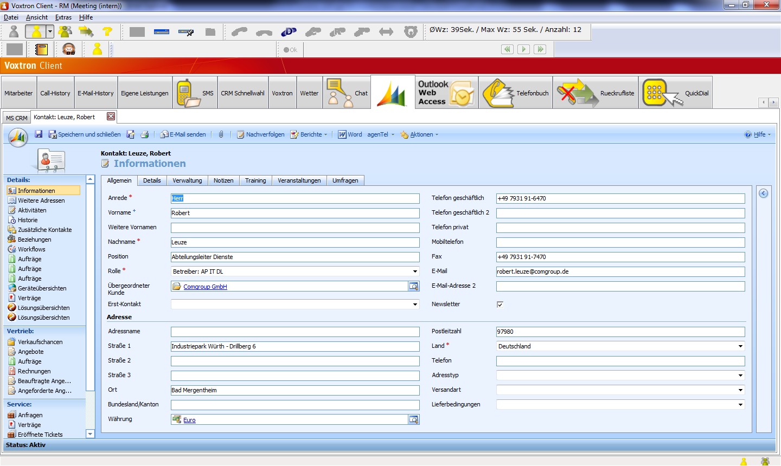
Example of an integration with Microsoft Dynamics CRM
Customer information from MS Dynamics
When the agent receives a contact in his/her Voxtron Client, a tab will open with information of the corresponding customer found in Microsoft Dynamics

Slide 4
Integration with Microsoft Dynamics and Voxtron’s outbound campaign dialer
When organising a CRM campaign, use Voxtron’s outbound campaign dialer
Microsoft Dynamics campaign lists can be loaded into the Voxtron outbound campaign dialer
The dialer module will manage preview, predictive*, power* or progressive* outbound campaigns
The results of the outbound campaign are reported back into the Microsoft Dynamics campaign
*Preview outbound available, progressive, power, predictive Q4 2012

Slide 5
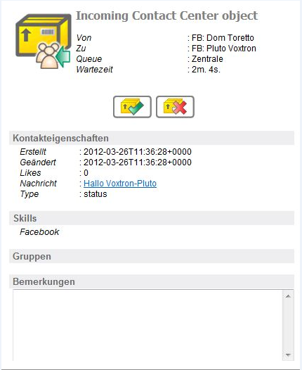
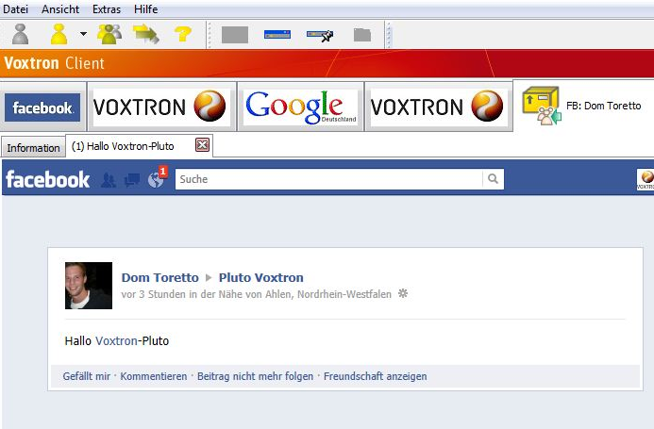
Example of an integration with Facebook
Tab opens with the Facebook post in the Voxtron Client
Link to the Facebook post in the Voxtron Client
The agent receives Facebook posts into his/her Voxtron Client, clicks on the link, replies to it and the answer will be posted on Facebook

Slide 6
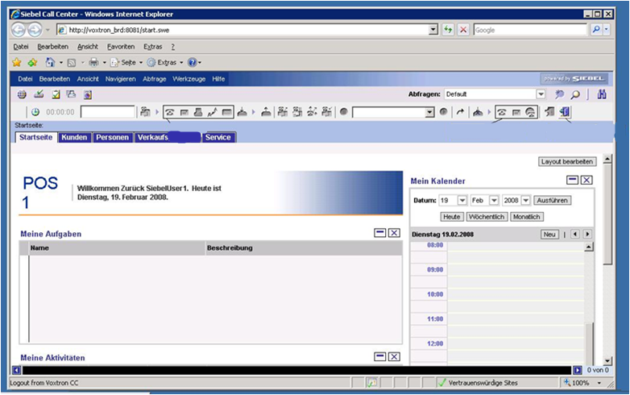
Example of an integration with Siebel
Call with the Voxtron Client
Log on and log off the Voxtron Client
The agent can use the Voxtron Client functionalities as
call, log on, log off,… in his/her Siebel client

Slide 7
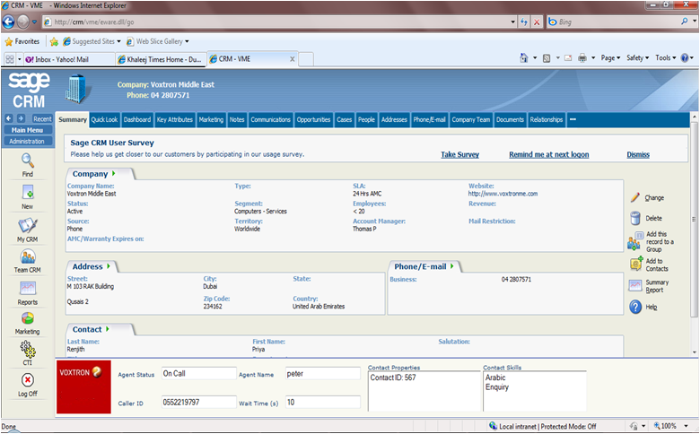
Example of an integration with Sage
Bar with data from the Voxtron Client
The agent can see the caller’s ID, caller’s waiting time, contact properties and skills from the Voxtron Client, in his Sage client, combined with Sage’s customer info

Slide 8
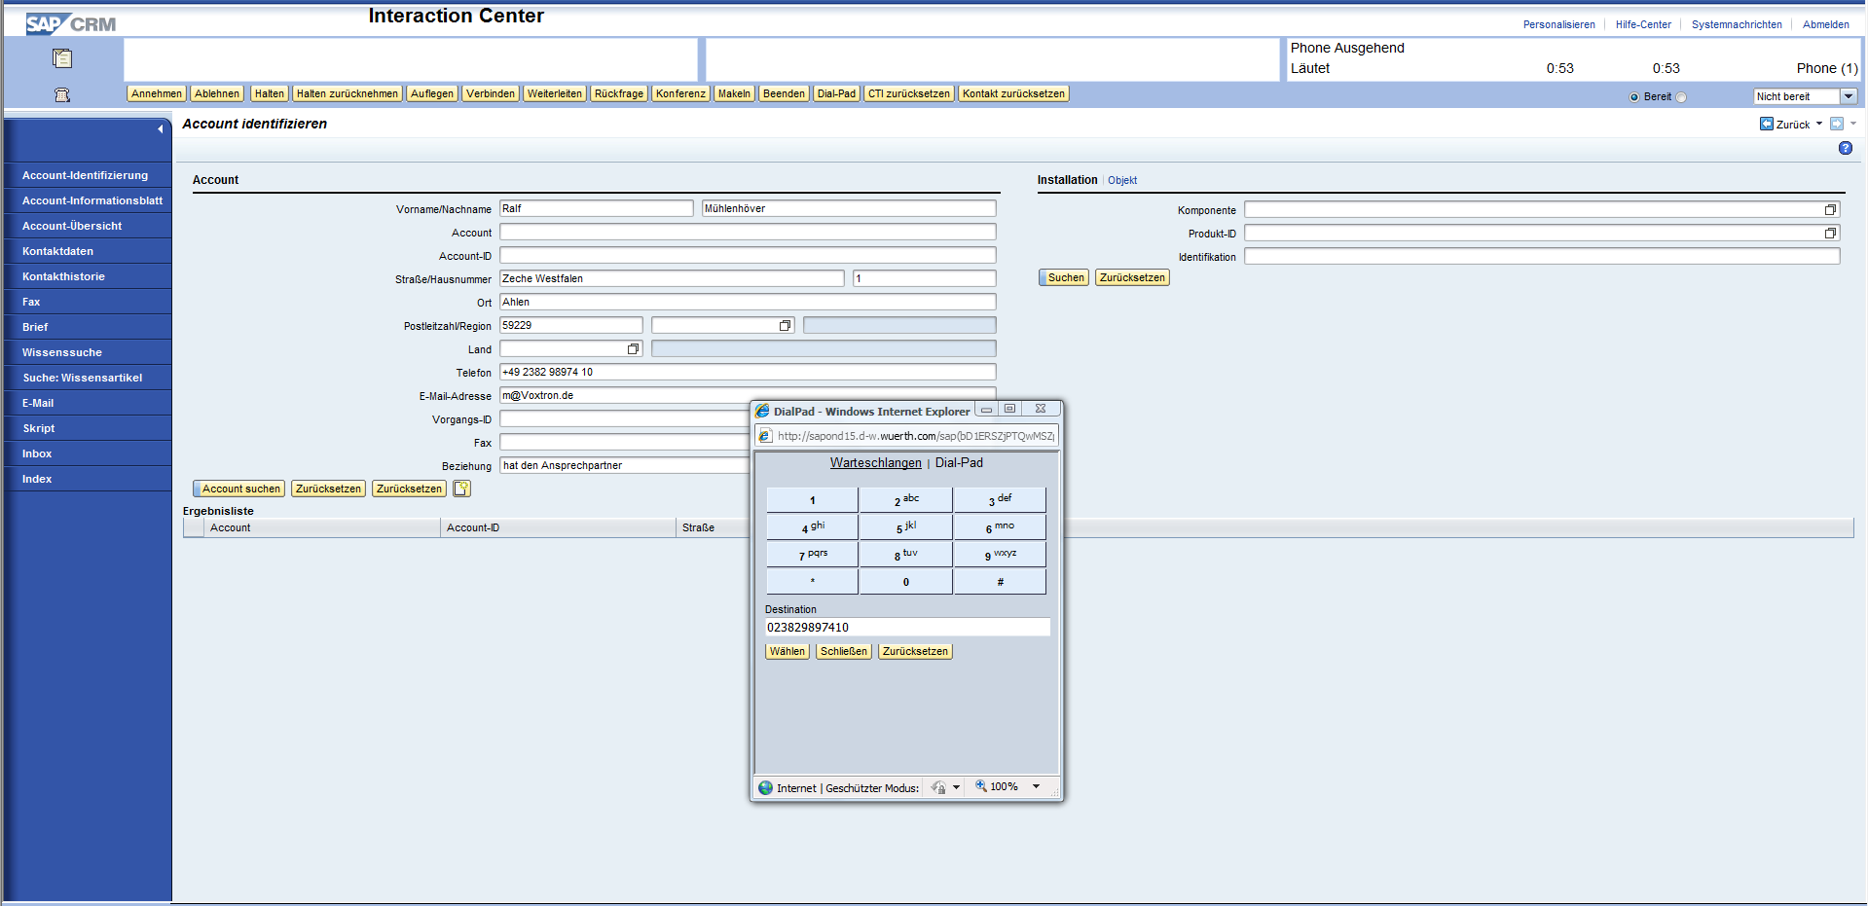
Example of an integration with SAP
Dialpad with Voxtron Client functionalities
The agent can perform Voxtron Client functionalities as calling, receive a call…into his SAP client

Slide 9
How can these integrations be done?
Voxtron has a large number of free SDKs available:
Toolbar SDK
Customise your own toolbar in the Voxtron Client
HTML SDK
Display customised HTML pages in the Voxtron Client
TCP/IP & .NET(COM) SDK
Use information from the Voxtron Client into your own application
Upload information from your application and show it in the Voxtron Client
Custom report/dashboard SDK
Customise your reports/dashboards by integrating the Voxtron Communication Center reports/dashboards with reports/dashboards from your current environment
Campaign SDK
Customise your campaigns by adding, modifying and deleting automatically campaigns or campaign data

Slide 10
How can these integrations be done?
Voxtron has a large number of free SDKs available:
Monitor SDK
Use activity and waiting monitor information into your applications
IVR plug-ins
Connects the call flow with external applications or databases
Administration SDK
Automate your Web Center administration
Web Contact SDK
Create a web chat application on your website, route objects (Facebook posts, Tweets, documents) in your contact center
Voxtron Client SDK
Use information from the Voxtron Client into your own applications
Create your own client

